Slide 1
Applications for machine learning in data science
Regression and classification are of primary importance to a data scientist.
The uses for regression and automatic classification are wide ranging, such as the following:
  Finding oil fields, gold mines, or archeological sites based on existing sites (classification and regression)
  Finding place names or persons in text (classification)
  Identifying people based on pictures or voice recordings (classification)
  Recognizing birds based on their whistle (classification)

Slide 2
Identifying profitable customers (regression and classification)
Proactively identifying car parts that are likely to fail (regression)
Identifying tumors and diseases (classification)
Predicting the amount of money a person will spend on product X (regression)
Predicting the number of eruptions of a volcano in a period (regression)
Predicting your company’s yearly revenue (regression)
Predicting which team will win the Champions League in soccer (classification)

Slide 3
Occasionally data scientists build a model(an abstraction of reality) that provides insight to the underlying processes of a phenomenon.
When the goal of a model isn’t prediction but interpretation, it’s called root cause analysis.
  Understanding and optimizing a business process, such as determining which
  products add value to a product line
  Discovering what causes diabetes
  Determining the causes of traffic jams

Slide 4
Types of machine learning
Broadly speaking, we can divide the different approaches to machine learning by the amount of human effort that’s required to coordinate them and how they use labeled
data—data with a category or a real-value number assigned to it that represents the outcome of previous observations.
Supervised learning: (Classification) learn by trying to find patterns in a labeled data set.
Unsupervised learning:(Clustering) don’t rely on labeled data and attempt to find patterns in a data set without human interaction (Class label/ Class Information is not available)

Slide 5
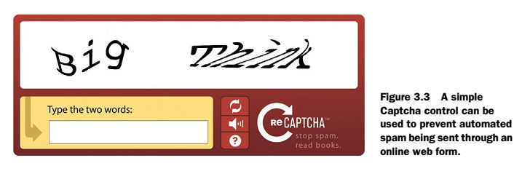
Supervised learning
CASE STUDY: DISCERNING DIGITS FROM IMAGES
One of the many common approaches on the web to stopping computers from hacking into user accounts is the Captcha check—a picture of text and numbers that the
human user must decipher and enter into a form field before sending the form back to the web server

Slide 6
CASE STUDY: DISCERNING DIGITS FROM IMAGES
Naive Bayes classifier, a simple yet powerful algorithm to categorize observations into classes.
let a computer recognize images of numbers.
Our research goal is to let a computer recognize images of numbers (step one of the data science process).
The data we’ll be working on is the MNIST database (Modified National Institute of Standards and Technology database) is a large database of handwritten digits that is commonly used for training various image processing systems

Slide 7
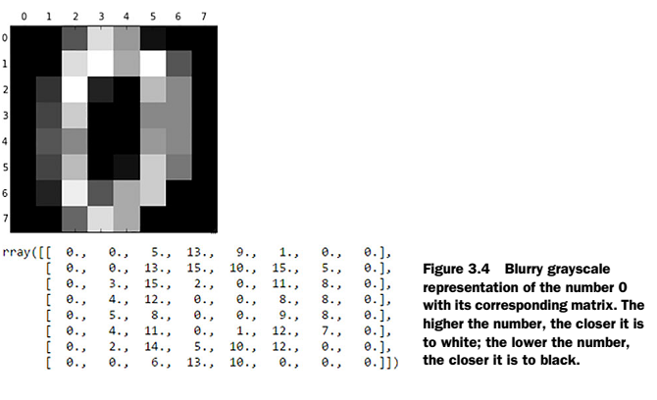
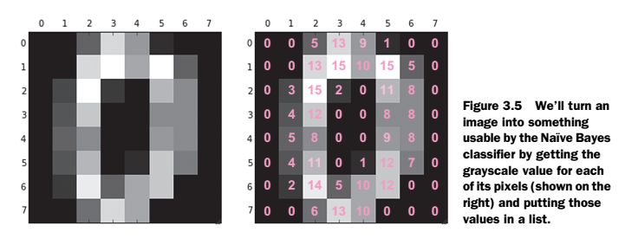

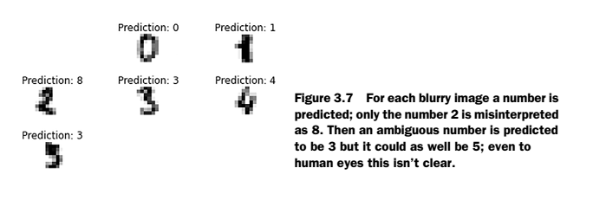

Slide 8
Classification Algorithm for Machine Learning
(Hybrid Neural Network Approach)

Slide 9
Fuzzy Min-Max
Neural Networks –Part 1: Classification

Slide 10
Pattern Recognition
The applications of Pattern Recognition can be found everywhere.
Examples include
disease categorization
prediction of survival rates for patients of specific disease,
fingerprint verification, face recognition, iris discrimination
chromosome shape discrimination
optical character recognition
texture discrimination, speech recognition, and etc.
General concepts of Pattern Recognition
(Supervised Learning) and Cluster Analysis (Unsupervised Learning) with
examples in texture and shape discrimination.
A Feasible design approach is to use some kind of model fitting or tuning based design set ; traditionally this has been called Learning .

Slide 11
Pattern Recognition cont…
Artificial Neural Network are a class of flexible semi-parametric models for efficient learning algorithms have developed over the years.
They have been extensively used for Pattern Recognition.
It seems that ANN can be used to an advantage in certain sub-problems especially feature extraction and Classification.
First stage in Pattern recognition is collection of data / data set .
Feature extraction : The Meaning FE is extracting raw data the information which is most relevant for classification purpose.

Slide 12
SDPTA
Single Discrete Perceptron Training Algorithm

Slide 13
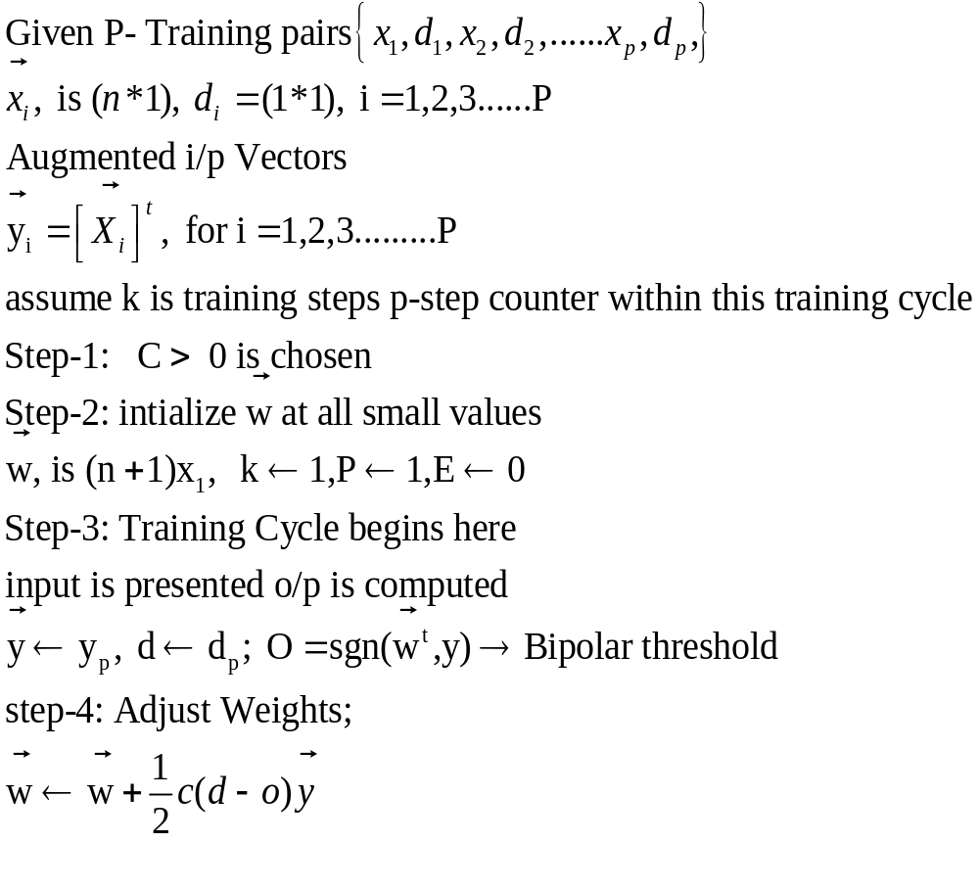

Slide 14
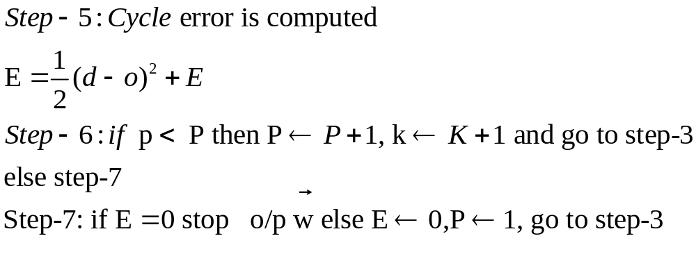

Slide 15
Program for Perceptron
NNTWARN OFF
clf reset
%colordef(gcf,'none')
%figure(gcf)
echo on
clc
pause % Strike any key to continue...
clc
P = [0 1 0 1 ; % Initialize Input Vector
0 0 1 1];
T = [0 1 1 0]; % Initialize Output Vector
% We can plot these vectors with PLOTPV:
plotpv(P,T);
% DEFINE THE PERCEPTRON
% INITP generates initial weights and biases for our neuron:
[W,b] = initp(P,T)
pause

Slide 16
W = [-0.8161 0.3078];
b = [-0.1680];
pause
echo on
clc
% TRAINING THE PERCEPTRON
% TRAINP trains perceptron to classify input vectors.
[W, b, epochs, errors] = trainp(W,b,P,T,-1);
pause
clc
ploterr(errors);
% USING THE CLASSIFIER
% We can now classify any vector we like using SIMUP.
p = [-0.5; 0];
a = simup(p,W,b)

Slide 17
SCPTA
Single Continuous Perceptron Training Algorithm

Slide 18
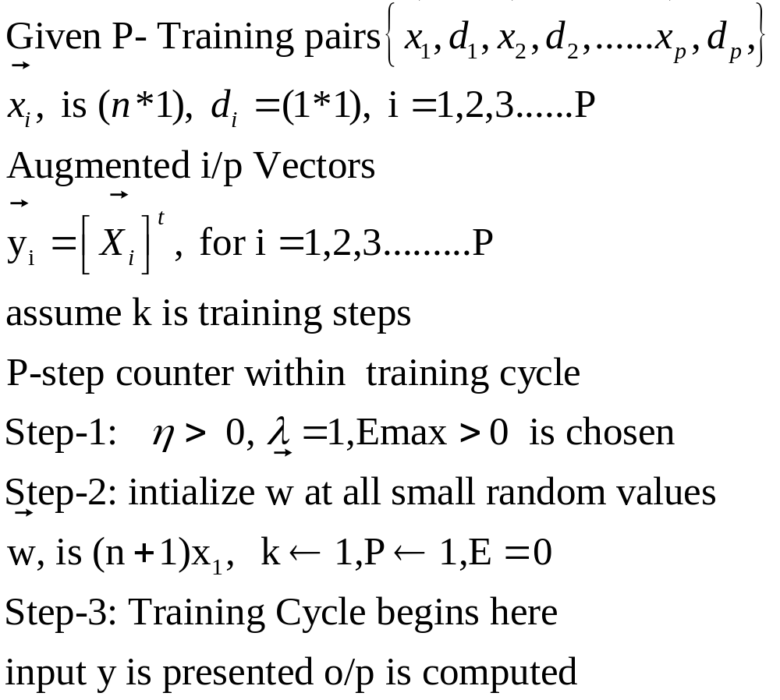

Slide 19
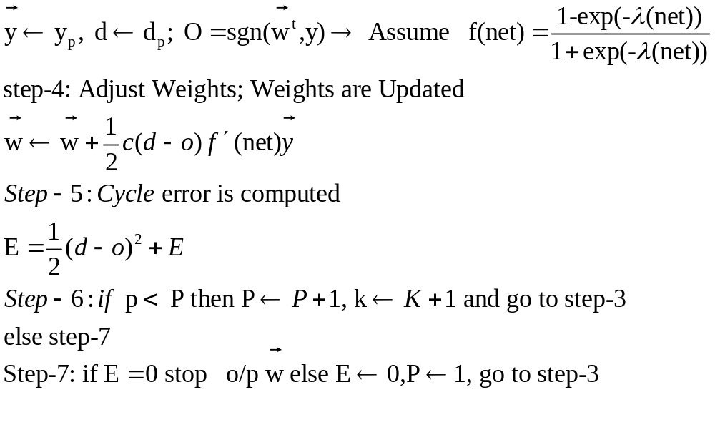

Slide 20
Program for SCPTA
clear all;
clc;
eata=input('enter the value of eata : ');
w=[0.1 0 0.3 0.2 0.1 0.1];
input = [-1 -4 -2 8 2 1 ;
-1 -8 -2 9 9 9 ;
-1 -3 -1 8 10 4;
-1 -4 -3 4 6 2 ;
-1 -5 -6 4 1 6 ;
-1 -10 -11 4 2 4 ];
d = [1 1 1 -1 -1 -1 ];
for p=1:1000
c=0;
for i=1:6
for j=1:6
x(1,j)=input(i,j);
end
t=w.*x; y=0;
for j=1:6

Slide 21
y=y+t(j);
end
if y<0
out=-1;
else
out=1;
end
if out==d(i)
w=w;
else
w=w+eata*(d(i)-out)*x; c=1;
end
end
if c==0
break;
else
end
end

Slide 22
if c==0
fprintf('perceptron is trained and \n');
fprintf('no of steps required for traing are = %d\n\n', p);
fprintf('and the weight vector is\n\n');
fprintf('w = %7.2f%7.2f%7.2f%7.2f%7.2f%7.2f\n',w(1),w(2),w(3),w(4),w(5),w(6));
else
fprintf('perceptron can not be trained in given steps\n');
fprintf('may train if steps are increased\n');
end
fprintf('\n\nplease verify the test results\n');
fprintf('outputs with the weight vector after training process are as follows\n\n');
for i=1:3
for j=1:6
x(1,j)=input(i,j);
end
t=w.*x;
y=0;

Slide 23
for j=1:6 y=y+t(j);
end
if y<0
w=w+eata*x; change=1;
else
w=w;change=0;
end
fprintf('y=%6.2f\n',y)
end

Slide 24
%Fuzzy Min-Max Neural Network Main Program
clear all; clc;
tic
N=2; %No of classes
P=400;%Index for counting hyperbox modification & No of patterns in the feature matrix
%lamda=0.00096; %Hyperbox size
lamda=0.000013
gamma=1; n=38;%Sensitivity parameter of membership function and No. elements in pattern vector
zz=n+1;
%normalisation of ring feature matrix in range 0 to 1
%load TRAINABDEF.MAT
load W.mat
RI= NORMsampleTEST;
maxx=max(max(RI)); RI=RI/maxx;

Slide 25
%appending class index;
for x=1:N:P
for y=1:N
RH(x+y-1,:)=[RI(x+y-1,:) y];
end
end
%Initialization of hyperboxes
for x=1:N
W(x,:)=RH(x,1:zz); V(x,:)=RH(x,1:zz); y=RH(x,zz); U(x,y)=1;
end

Slide 26
%Learning of Fuzzy Min Max Neural Network begins here
len_vect_hyp=0;
for p=1:P
p
flag_1=0; flag_2=0; %Flag to indicate the expansion of hyperbox
% i.e. for Overlap test
flag2=0; %Flag to indicate the result of overlap test of
% hyperboxes that indicates need of "Contracton process"
flag3=0;
cl_index=RH(p,zz);
[v_row v_col]=size(V);
% To find vector containing indices of hyperboxes
% corresponding to the class of applied pattern and also its length
t1=0;
len_vect_hyp=0;
for i=1:v_row
if cl_index==V(i,zz)
len_vect_hyp=len_vect_hyp+1;
t1(len_vect_hyp)=i; end end t1;

Slide 27
%To find membership values of hyperboxes corresponding
%to a class of applied pattern and store in vector b
b=0;
for i=1:len_vect_hyp
sum=0;
for j=1:n
a1=RH(p,j)-W(t1(i),j);
a2=V(t1(i),j)-RH(p,j);
sum=sum+(1-rampfun(a1,gamma)-rampfun(a2,gamma));
end
b(i)=sum/n;
end
b;

Slide 28
%Calculate index of hyperbox to be tested for expansion and
%store the index in the variable max_val_index
%Test the hyperbox for "Expansion test"
%Expand the hyperbox if condition is satisfied
%else create new hyperbox
[max_mem_val max_val_index]=max(b);
sum=0;
ind=max_val_index;
for j=1:n
max(W(t1(ind),j),RH(p,j));
min(V(t1(ind),j),RH(p,j));
sum=sum+(max(W(t1(ind),j),RH(p,j))-min(V(t1(ind),j),RH(p,j)));
end
if n*lamda >=sum
for j=1:n
V(t1(ind),j)=min(V(t1(ind),j),RH(p,j));
W(t1(ind),j)=max(W(t1(ind),j),RH(p,j));
flag_1=1;
end

Slide 29
else
W=[W;RH(p,:)];
V=[V;RH(p,:)];
U1=zeros(N,1);
y=RH(p,zz);
U1(y,1)=1;
U=[U U1]; flag_2=1;
end
% Hyperbox "Overlap test" to be carried if flag1=1
% While testing for overlap find smallest overlap along
% any dimension and index of dimension
del_old=1;
if flag_2==1
[j dt]=size(W);
else
j=t1(ind);
end

Slide 30
if flag_1==1|flag_2==1
exp_hpbx_clind=V(j,zz);
[w_row w_col]=size(W);
for k=1:w_row
flag3=0;flag4=0;flag5=0;flag6=0;
if V(k,zz)~=exp_hpbx_clind
for i=1:n
del_new=1;
if V(j,i)<V(k,i)& V(k,i)<W(j,i)&W(j,i)<W(k,i)
del_new=min((W(j,i)-V(k,i)),del_old);flag3=1;
end
if V(k,i)<V(j,i)& V(j,i)<W(k,i)& W(k,i)<W(j,i)
del_new=min((W(k,i)-V(j,i)),del_old);flag4=1;
end
if V(j,i)<V(k,i)& V(k,i)<W(k,i)& W(k,i)<W(j,i)
del_new=min(min((W(k,i)-V(j,i)),(W(j,i)-V(k,i))),del_old);flag5=1;
end

Slide 31
if V(k,i)<V(j,i) & V(j,i)<W(j,i)& W(j,i)<W(k,i)
del_new=min(min((W(j,i)-V(k,i)),(W(k,i)-V(j,i))),del_old);flag6=1;
end
de_new(i)=del_new;
end
[de_new_min delta]=min(de_new);
if flag3==1|flag4==1|flag5==1|flag6==1
[W,V]=contran(j,k,W,V,delta); %"Hyperbox contraction" function
end
end
end
end
end
save min_max_pt_1000.mat W V U RH lamda gamma n N P zz;
fprintf('Training ends here\n');
el_t=toc

Slide 32
Supervised Learning Algorithm
Delta Learning Rule

Slide 33
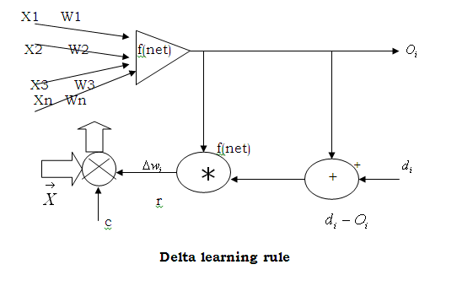
Supervised Learning Algorithm
Delta Learning Rule
The delta-learning rule is only valid for continuous activation function & supervised training mode the learning signal for this rule is called delta and is defined as follows.

Slide 34
The Insides of Delta Rule
Backpropagation performs a gradient descent within the solution's vector space towards a global minimum.
The error surface itself is a hyperparaboloid but is seldom smooth as is depicted in the graphic below. Indeed, in most problems, the solution space is quite irregular with numerous pits and hills which may cause the network to settle down in a local minimum which is not the best overall solution

Slide 35
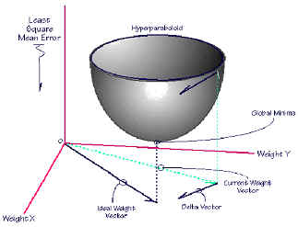
The Insides off Delta Rule (continued) http://users.epp.teiher.gr/mathimata/neural/contents/insides_off_delta_rule.htm

Slide 36
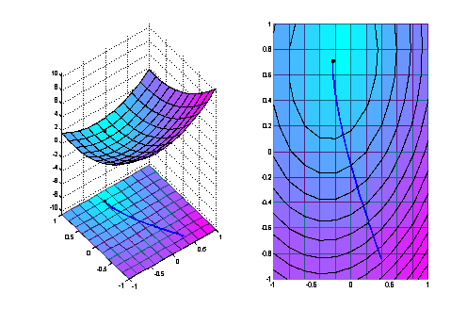
Error Surface

Slide 37
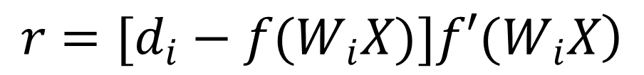

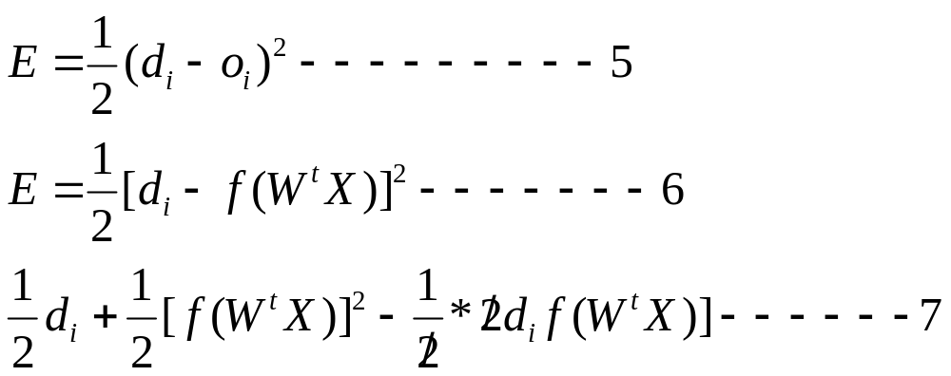
Squared Error
Where is the derivative of the activation function f(net)
Compound for

Slide 38
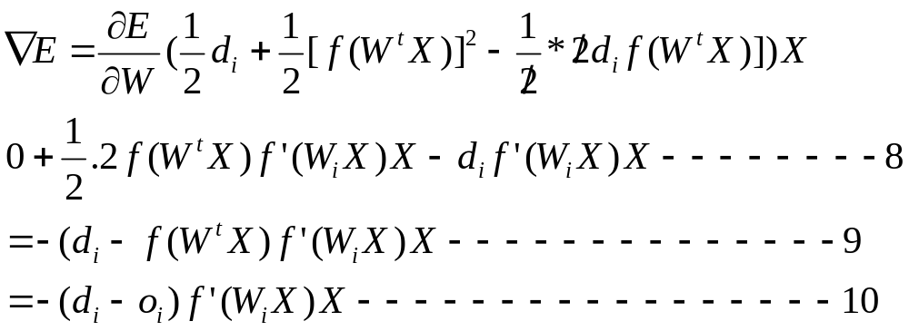

Slide 39
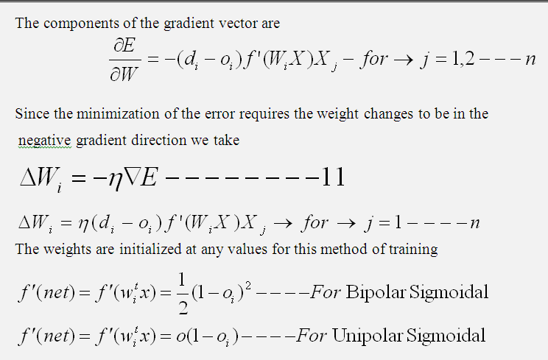

Slide 40
Delta Learning rule Continued...
in=[1 1 0 0 -1;1 0 0 1 -1; 0 0 1 1 -1; 0 1 1 0 -1];
out=[1 1; 1 0; 0 1; 0 0];
eta=input('Enter the learning rate value = ');
it=input('Enter the number of iterations required = ');
wgt=input('Enter the weights,2 by 5 matrix(including weight for bias):\n');
for x=1:it
for i=1:4
s1=0;
s2=0;
for j=1:5
s1=s1+in(i,j)*wgt(1,j);
s2=s2+in(i,j)*wgt(2,j);
end

Slide 41
Delta Learning rule
wi=eta*(out(i,1)-logsig(s1))*dlogsig(s1,logsig(s1))*in(i,:);
wgt(1,:)=wgt(1,:)+wi;
wi=eta*(out(i,2)-logsig(s2))*dlogsig(s2,logsig(s2))*in(i,:);
wgt(2,:)=wgt(2,:)+wi;
end
end
wgt

Slide 42
Classification Algorithms
Basic Principle (Inductive Learning Hypothesis): Any hypothesis found to approximate the target function well over a sufficiently large set of training examples will also approximate the target function well over other unobserved examples.
Typical Algorithms:
Decision trees
Rule-based induction
Neural networks
Fuzzy Neural Networks
Memory(Case) based reasoning
Genetic algorithms
Bayesian networks

Slide 43
Fuzzy Min-Max
Neural Networks –Part 1: Classification

Slide 44
Some Fundamentals
Example patterns
Pattern Classification and Recognition
Geometrical Interpretation of Patterns
An n dimensional unit pattern space
Crisp sets, probability and Fuzzy sets
Fuzzy set as a pattern class
Aggregation of fuzzy sets as one pattern class

Slide 45
Abstract
It is a Supervised Learning Neural Network classifier that utilizes fuzzy sets as pattern classes.
Each Fuzzy set is an aggregate (union) of fuzzy set hyperboxes.
A Fuzzy set hyperbox is an n-dimensional box defined by a min point and max point with corresponding membership function.
The Min-Max point are determined by fuzzy min-max learning algorithm.
It describes the relationship between fuzzy sets and pattern classification.
It outlines the learning and recall algorithms

Slide 46
Several properties that a pattern classifier should possess.
On-Line Adaptation:
Nonlinear Separability:
Overlapping Classes
Training Time:
Soft and Hard Decisions:
Verification and Validation
Tuning Parameters:
Nonparametric Classification

Slide 47
The supervised FMM learning algorithm consists of three steps:
Expansion : Identify the hyperbox that can expand and expand it. If an
expandable hyperbox cannot be found, add a new hyperbox for
that class.
II) Overlap Test : Determine if any overlap exists between hyperboxes from
different classes.
III) Contraction : If overlap between hyperboxes that represent different classes does exist, remove the overlap by minimally adjusting each of the hyperboxes.

Slide 48



Hyper box
Max Point
Min Point
The min-max hyperbox in is shown. The min and max points are all that are required to define the hyperbox. A membership function is associated with the hyperbox that determines the degree to which any point is contained within the box. A collection of these boxes forms a pattern class.

Slide 49
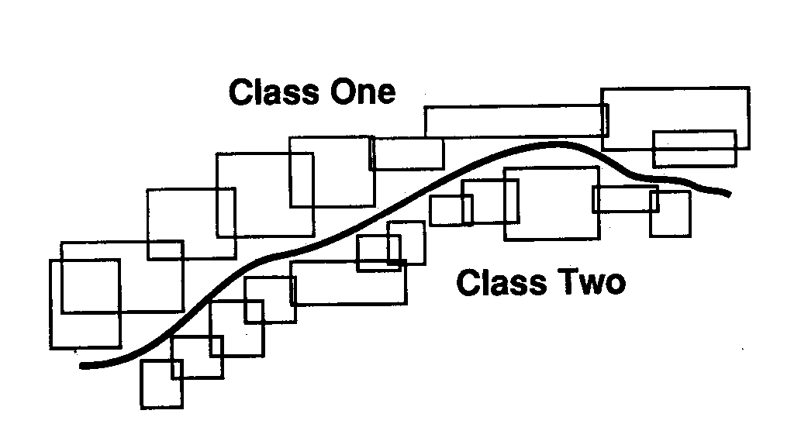
An Example of fuzzy min-max hyperboxes placed along the boundary of two class problem.

Slide 50
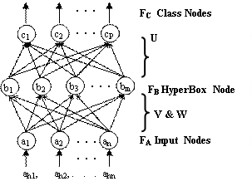
TOPOLOGY OF FUZZY MIN-MAX
NEURAL NETWORK

Slide 51
TOPOLOGY OF FUZZY MIN-MAX
NEURAL NETWORK
It is a three layer Neural Network that implements the Fuzzy Min-Max
neural network.
The Input layer F_{A}=(a₁, a₂, ………, a_{n}) has n processing elements, one for each of the n dimensions of the input pattern A_{h}.
There are two sets of connections between each input node and each of the m hyperbox fuzzy set nodes found in the layer F_{B} = (b₁, b₂, ….,b_{m}).
These dual connections are adjusted using the fuzzy min-max classification learning algorithm.
The connections between the FB nodes and the P output nodes F_{C}=(C₁,C₂,…,Cp) are binary valued determined as each F_{B} node is added during learning

Slide 52
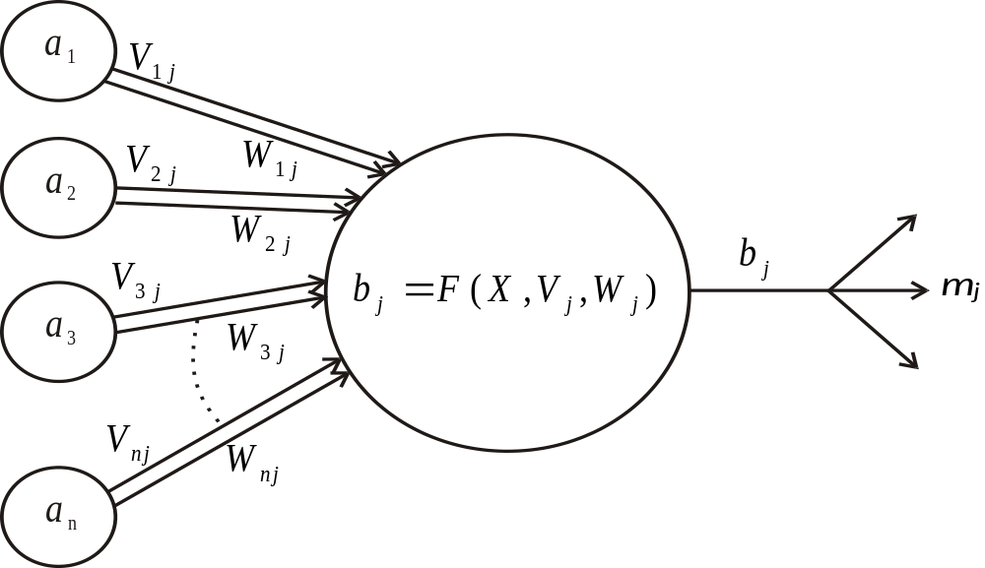

Implementation of fuzzy hyperbox
Let the j^{th} hyper box fuzzy set, B_{j} be defined by the order set:

Slide 53





FUZZY MIN-MAX CLASSIFICATION
LEARNING ALGORITHM
Fuzzy min-max learning is an expansion / contraction process.
The training set D consists of a set of M ordered pairs
Where is the input pattern and
is the index of one of the classes.
The learning process begins by selecting an ordered pair from D and finding a hyperbox for the same class that can expand (if necessary) to include the input.
if hyperbox cannot be found that meets the expansion criteria, a new hyperbox is created / formed and added to the neural network.
This growth process allows classes to be formed that are nonlinearly separable.
Hyperbox overlap is not a problem from same class but it should eliminate from different class.
Size of the hyperbox is bounded above by

Slide 54
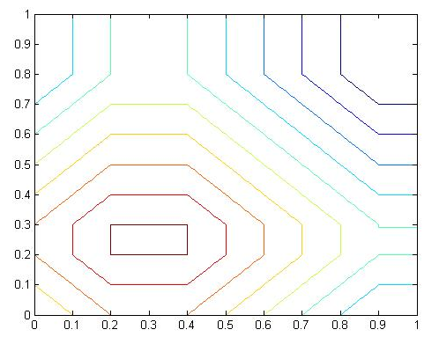
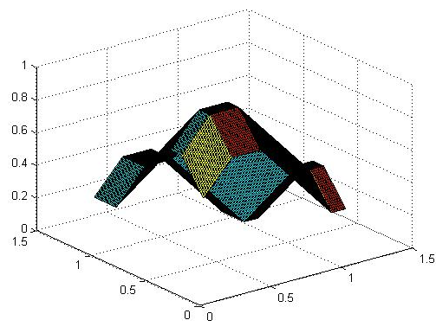





Plot of Membership function b_{j} for the hyperbox defined by
Min-point[ 0.2 0.2] and Max-point W=[0.3 0.4]

Slide 55


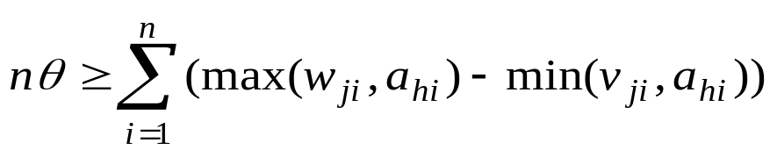



  Hyperbox Expansion
  Given the training pair , and (A_{h} , d_{h}) find the hyperbox B_{j} which provides the highest degree of membership, allows expansion (if necessary ) and represents the same class as the degree of membership is measured using equation
If the expansion criterion has been met for hyperbox min point of the hyperbox is adjusted using the equation
and the max point is adjusted using the equation
Max Point
Min Point

Slide 56






  Hyperbox Overlap Test:
  Considering that the hyperbox was expanded from the above step
  and that the hyperbox represents another class and it is to be tested for
  possible overlap class.
  The four test cases is satisfied for each of the dimension

Slide 57



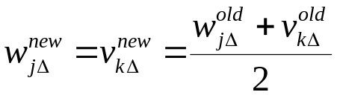
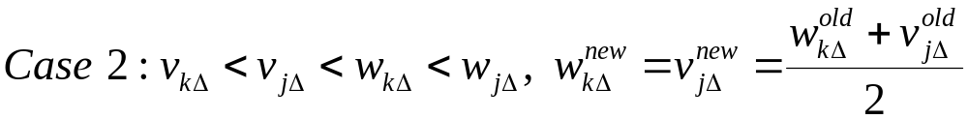




  Hyperbox Contraction
  If an overlap between two hyperboxes is identified, an immediate contraction is done to overlap. The elimination of the overlap is done on dimension-by-dimension basis. The contraction process carried out as below.
If then the dimensions of the two hyperboxes are adjusted.
To determine the proper adjustment to make, the same four cases are studied.

Slide 58
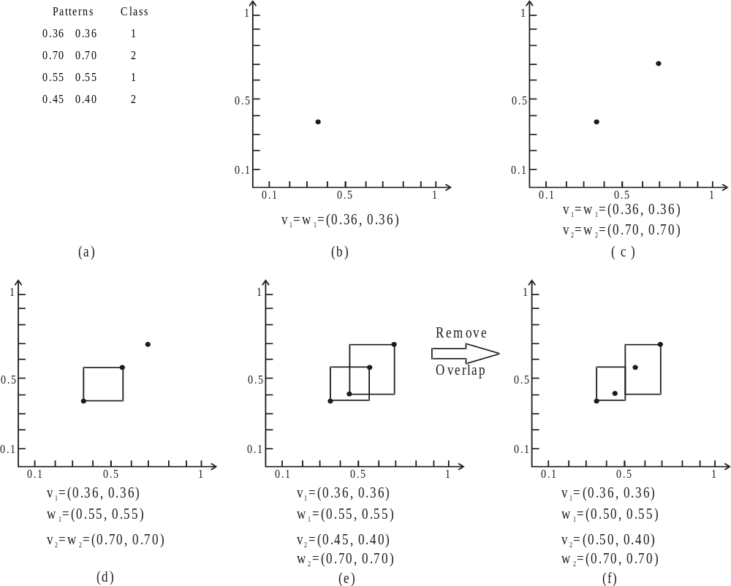
Scatter plot of Iris Patterns for two classes (b) first input pattern (0.36, 0.36) of class 1.
(c) second input pattern (0.70, 0.70) of class 2. (d) third input pattern of class 1 is tested which falls in hyperbox b1 and expanded (e) overlap of hypberbox b1 and b2. (f) removal of overlap with b1 and b2 with v₂=(0.50, 0.40) w₁=(0.50, 0.55).

Slide 59
Modified Fuzzy Hypersphere Neural Network with Different Distance Measures

Slide 60
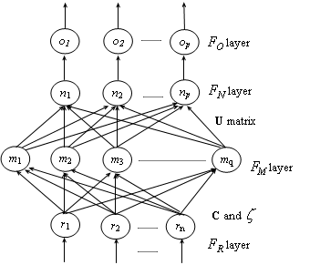

Modified Fuzzy Hypersphere Neural Network Approach for Iris Recognition
delivers non-fuzzy o/p O_{k}=1 if n_{k} < T otherwise, O_{k}=0.
represents the degree to which the I/p pattern belongs to the Class n_{k}
Weights are stored in U . Assigned From F_{M} to F_{N} &
updated
This layer is constructed during training
This accepts an input patterns

Slide 61
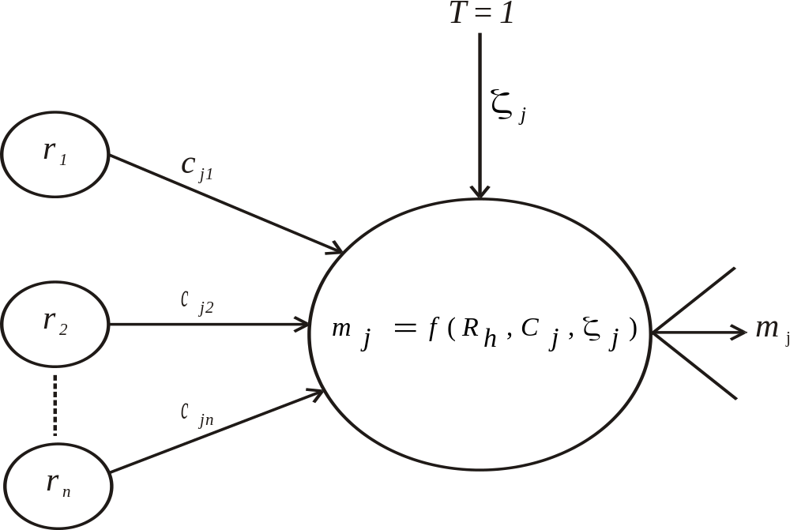



Implementation Modified Fuzzy Hypersphere Neural Network
represents center point of the hypersphere
weight assigned to this link is represents radius of hypersphere

Slide 62





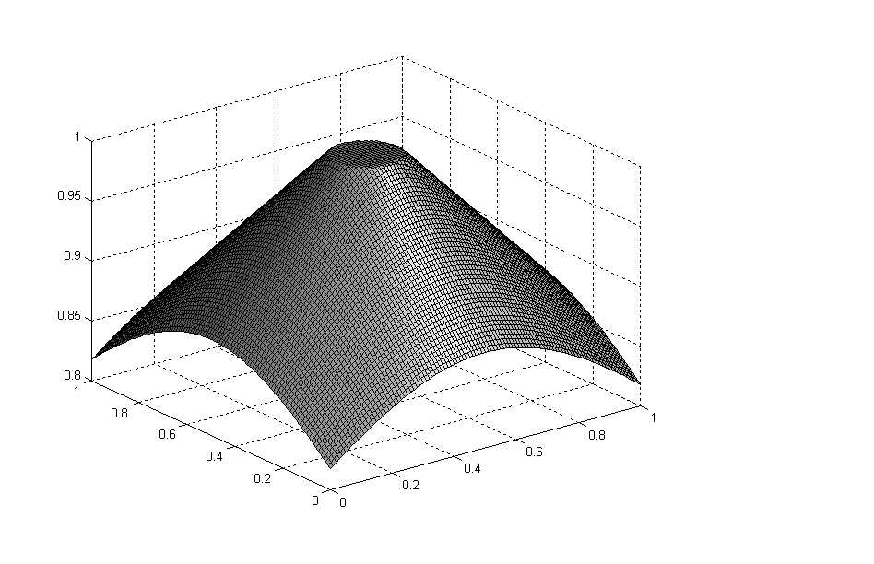

Assuming the training set defined as
where is the pattern , the membership function of the hypersphere node is
The membership function returns m_{j} = 1 if the input pattern R_{k}
is contained by the R_{k} hypersphere.
Plot of Modified Fuzzy Hypersphere Membership Function for = 1

Slide 63

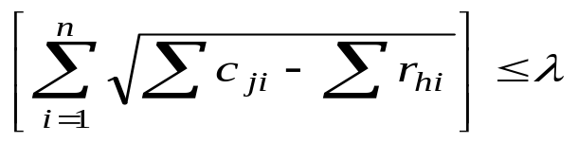
MFHSNN Learning Algorithm
The supervised FHSNN learning algorithm for creating fuzzy hyperspheres in hyperspace consists of three steps.
Creating of HSs
Given the hth training pair (R_{h} , d_{h}) find all the hyperspheres belonging to the class d_{h}. These hyperspheres are arranged in ascending order according to the distances between the input pattern and the center point of the hyperspheres
i) If the pattern R_{h} falls outside the hypersphere, then the hypersphere is expanded to include the pattern if the expansion criterion is satisfied. For the hypersphere to include the following constraint must be met.

Slide 64
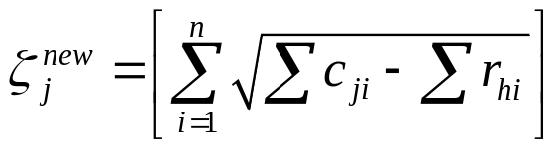


for testing expansion of new hyperspheres based on Bhattacharyya distance which is sum of the absolute differences.
If the expansion criterion is met then pattern is included as:
If the pattern is not included by any of the above steps then new hypersphere is created for that class, which is described as:

Slide 65

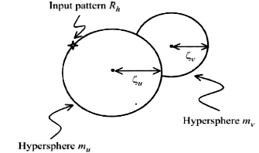
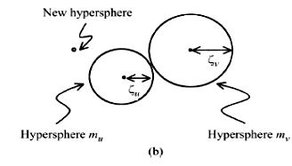
2. Overlap Test :
If the created hypersphere falls inside the hypersphere of other class means there is an overlap.
The learning algorithm allows overlap of hyperspheres from the same class and eliminates the overlap between hyperspheres from different classes.
if means two hyperspheres from
different classes are overlapping.
Status of the hyperspheres before removing an overlap in step 2.
Status of the hyperspheres after removing an overlap in step 2

Slide 66


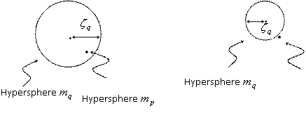
3. Removing overlap:
If step 2 has created overlap of hyperspheres then it is removed by restoring the radius of just expanded hypersphere.
Let be the expanded hypersphere then it is contracted as,
and new hypersphere is created for the input pattern

Slide 67
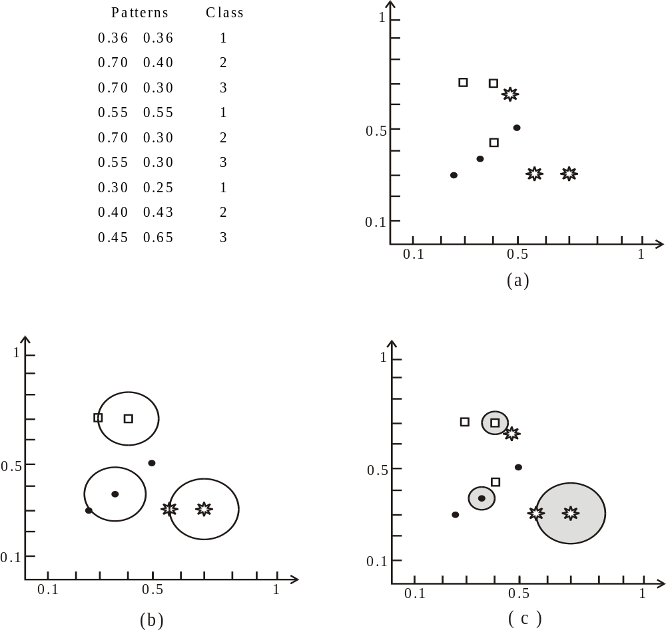
Plot of MFHSNN algorithm with three class 2-D example
Pattern set and its scatter plot, in which circles, squares, and stars represent class 1, 2 & 3, respectively,
b) Hyperspheres created after applying six patterns, (c) Hyperspheres created after training,

Slide 68
PERFORMANCE EVALUATION OF DIFFERENT DISTANCE MEASURES ON MFHSNN
Distance Measures | Training Time in Seconds | Recall Time in Seconds | Hypersphere
Euclidean | 0.830694 | 31.780012 | 347
Manhattan | 0.867152 | 31.660341 | 364
Bhattacharya | 0.750051 | 23.801397 | 377
RECOGNITION RATE OF MFHSNN
Methodology | Recognition rate | Classifiers
Daugman | 99.25 | HD, SVM
Wildes | 97.43 | Normalized Correlation
Y.Wang | 99.57 | WED
Ali | 95.20 | HD, WED
MFHSNN | 94.00 | MFHSNN

Slide 69
RECOGNITION RATE FOR THREE DIFFERENT DATA SETS
Data Set | Training Patterns | Testing Patterns | Recognition rate %
1st Set | 125 | 50 | 100%
2nd Set | 380 | 190 | 100%
3rd Set | 540 | 216 | 94%

Slide 70
Modified Fuzzy Hyperesphere Neural Network
clear all; clc;
tic
N=2; P=15000; delta=0.1; rad_lmt=0.08; in_rad=0; %No. of patterns %No. of classes
gamma=1; n=42; zz=n+1; yy=zz+1; %Sensitivity pararship function and No. elements in pattern vector meter of member
load KDDTrain20Percent.mat;
RI= M;
maxx=max(max(RI)); RI=RI/maxx;
%appending class index;
for x=1:N:P
for y=1:N
RH(x+y-1,:)=[RI(x+y-1,:) y];
end
end
CP=0; U=0;

Slide 71
Modified Fuzzy Hyperesphere Neural Network
%Learning of Neural Network begins here
for p=1:P
for temp=1:1
p
if CP==0 & U==0
CP=RH(p,:); CP=[CP in_rad];
%fprintf('First Input pattern is included by creating new hypersphere because three are no hyperspheres at all\n');
U1=zeros(N,1); y=RH(p,zz); U1(y,1)=1; U=U1;
%pause;
break;
end

Slide 72
Modified Fuzzy Hyperesphere Neural Network
RH(p,:); cl_index=RH(p,zz);
[cp_row cp_col]=size(CP);
%To find vector containing indices of hyperspheres corresponding to the class of applied pattern and unlabeled hyperspheres
t1=zeros(1,2);
len_vect_hyp=0;
for i=1:cp_row
if cl_index==CP(i,zz)
len_vect_hyp=len_vect_hyp+1;
t1(len_vect_hyp,1)=i;
end
end

Slide 73
Modified Fuzzy Hyperesphere Neural Network
%This segment creates new hypersphere and updates U matrix if there is no hypersphere belonging to the class of input pattern
if t1(1,1)==0
temp1=RH(p,:); temp1=[temp1 in_rad]; CP=[CP; temp1];
fprintf('Input pattern is included by creating new hypersphere because three is no hypersphere of that class\n');
U1=zeros(N,1);
y=RH(p,zz);
U1(y,1)=1;
U=[U U1];
%pause;
break;
end

Slide 74
Modified Fuzzy Hyperesphere Neural Network
%find the distance of input pattern with these hyperspheres of and store with the corresponding index
if t1(1,1)~=0
[t1_row t1_col]=size(t1);
for i=1:t1_row
pt1=RH(p,1:n);
pt2=CP(t1(i,1),1:n);
distance=dist(pt1,pt2');
t1(i,2)=distance;
end
end
%pick up the index of the HS which is most suitable for expansion, i.e. HS closest to the input pattern
[m1 m2]=min(t1(:,2)); index=t1(m2);

Slide 75
Modified Fuzzy Hyperesphere Neural Network
%Test first whether the input pattern falls in the specified radius of any hypersphere if %yes go to next pattern else
%test the most suitable hypersphere for expansion criteria and expand the hypersphere if condition is satisfied.
%As soon as any hypersphere is expanded, overlap test is carried with all hyperspheres of other classes.
ind=len_vect_hyp; b=0; flag1=0; flag2=0; flag3=0; flag4=0;
for s=1:1
pt1=RH(p,1:n); pt2=CP(index,1:n); r_pat=dist(pt1,pt2');
if r_pat>rad_lmt
flag1=1;
%fprintf('New pattern can not be included by expansion\n');
break;
end

Slide 76
Modified Fuzzy Hyperesphere Neural Network
r_pre=CP(index,yy);
b(s)=1-mem_fun2(r_pat,r_pre,gamma);
%Program segment to test that whether pattern falls in already created hypersphere if yes go to next pattern
if b(s)==1
%fprintf('New pattern is in previously created hypersphere"\n');
flag2=1;%pause;
break;
end
%Program segment to verify wheather the new pattern can be included by expanding the hypersphere.
%The hypersphere is expanded if the redius limit allows.
if r_pat<=rad_lmt
CP(index,yy)=r_pat; %pause;
flag3=1; flag3; %flag3 indicates possibility of overlap
%fprintf('Input pattern is included by expansion of hypersphere\n');
end

Slide 77
Modified Fuzzy Hyperesphere Neural Network
%d1--radius of other class hypersphere %d2--radius of just extended hypersphere %d-- distance between centres of both the hyperspheres
if flag3==1
for k=1:cp_row
flag4=0;
if CP(index,zz)~=CP(k,zz)
d1=CP(k,yy); d2=r_pat;
d=dist(CP(k,1:n),CP(index,1:n)');
if d <=d1+d2
flag4=1; flag4;
%fprintf('But it has created overlap of hyperspheres of different classes\n');
%fprintf('Therefore expanded hypersphere is contracted to previous size\n');
CP(index,yy)=r_pre;
break;
end
end
end

Slide 78
Modified Fuzzy Hyperesphere Neural Network
if flag4==0
%fprintf('and expansion created no overlap of different classes\n');
break;
end
end
%------------------------------------------------------
end
flag5=0;
if flag1==1 | flag4==1
temp1=RH(p,:); temp1=[temp1 in_rad]; CP=[CP; temp1]; %fprintf('When there is no hypersphere which can be expanded (flag1=1) to include the pattern\n')
%fprintf('OR if the expanded hypersphere creates possibility of overlap (flag3=1) \n')

Slide 79
Modified Fuzzy Hyperesphere Neural Network
%New hypersphere is created therefore possibility of overlap with previous hyperspheres
if flag5==1 % if created HS is unlabeled no need to test and remove overlap
%else if created HS is labeled and falling in unlabeled HS then label the unlabeled HS
for k=1:cp_row %else if created HS is labeled and falling in labeled HS of other class then contract the other HS
if cl_index~=CP(k,zz)
pt11=CP(cp_row+1,1:n); pt22=CP(k,1:n);
r_pat=dist(pt11,pt22'); r_pre=CP(k,yy);
b=1-mem_fun2(r_pat,r_pre,gamma);
if b==1
CP(k,yy)=r_pat-delta;
break;
end end end end

Slide 80
Modified Fuzzy Hyperesphere Neural Network
if cl_index~=CP(k,zz)
pt11=CP(cp_row+1,1:n); pt22=CP(k,1:n);
r_pat=dist(pt11,pt22'); r_pre=CP(k,yy);
b=1-mem_fun2(r_pat,r_pre,gamma);
if b==1
CP(k,yy)=r_pat-delta;
break;
end end end end end
%CP %pause
end
save train_final_1000.mat CP yy rad_lmt U RH P n N zz gamma;
CP;
U;
%fprintf('Training ends here\n');
toc
size(CP);

